Slide 1
Data Management for the New and Expected Baseline Sampling Rules
www.geotech.com
Dr. David W. Rich
drdave@geotech.com
Denver, CO
May 6, 2014

Slide 2
Introduction
Petroleum project challenges
Petroleum data challenges
Types of petroleum environmental data
Baseline sampling
Example state sampling rules
Colorado Rules 609 and 318A
Future direction and discussion
www.geotech.com

Slide 3
Petroleum Project Challenges
Petroleum environmental projects from upstream to downstream have different needs:
Baseline samples should be taken prior to and after drilling
Accidental spills during drilling may require sampling and analysis
Hydraulic fracturing is now under great scrutiny from a number of angles: water supply, fluid composition, and disposal or re-use of frac fluids
Unconventional resources such as coalbed and shale gases often involve the production of a large amount of water, which must be managed, and often discharge monitoring reports must be provided to regulators
Transportation activities, such as by pipeline and truck, can result in spills with environmental impact
Refining has its own set of environmental issues, such as monitoring of discharges to nearby groundwater and surface water
www.geotech.com

Slide 4
Petroleum Data Challenges
Petroleum environmental data provides special challenges:
Handling on non-detected results
Multiple dilutions to maintain a linear instrument response
Comparison to multiple, and often complex, regulatory limits and target levels
Special handling of non-aqueous phase liquid data
Potentially large amounts of data
Inconsistent reporting of hydrocarbon ranges
Often complex site geology
www.geotech.com

Slide 5
Baseline Sampling
Program requirement types
Voluntary - Example: Pennsylvania, NY
Mandatory - Examples: COGCC, Ohio
Timing
Pre-drilling
Post-drilling
Reporting requirements
Agency
Operator
Landowner
www.geotech.com

Slide 6
Example State Sampling Rules
State | Agency | Summary of Rules | Reference
Alabama | State Oil and Gas Board of Al | Sampling apparently not required | gsa.state.al.us/documents/misc_ogb/goldbook.pdf
Alaska | Alaska Oil and Gas Conservation Commission | Sampling apparently not required | dog.dnr.alaska.gov/AboutUs/OGStatutes.htm
Arkansas | Arkansas Oil and Gas Comm. | Sampling apparently not required | aogc.state.ar.us/operator_requirements.htm
California | Division of Oil, Gas and Geothermal Resources | May be required by state supervisor or landowner | ftp://ftp.consrv.ca.gov/pub/oil/laws/PRC01.pdf
Colorado | Colorado Oil and Gas Conservation Commission | Baseline sampling before and after drilling as of May 1, 2013 | cogcc.state.co.us/RR_HF2012/Groundwater/FinalRules/FinalRule609-01092013.pdf
Idaho | Idaho Department of Lands | Baseline sampling before drilling, as of March 29, 2012 | www.idl.idaho.gov/oil-gas/commission/2013-faq-fracking.pdf
Illinois | Dept. of Natural Resources | Mandatory sampling being considered in HB2615 | http://www.ilga.gov/legislation/BillStatus.asp?DocNum=2615&GAID=12&DocTypeID=HB&SessionID=85&GA=98
Kansas | Kansas Geological Survey | Baseline sampling voluntary | www.kcc.state.ks.us/conservation/kgs_baseline_groundwater_quality.pdf
Louisiana | Louisiana Dept. of Nat. Res. | Sampling apparently not required | dnr.louisiana.gov/assets/OC/43XIX_June2010.pdf
Michigan | Michigan Dept. of Environmental Quality | Up to the landowner | www.michigan.gov/documents/deq/EQP_6553_Homeowner_Water_Sampling_Information_399756_7.pdf
New Mexico | New Mexico Energy, Minerals and Natural Resources Dept. | Sampling apparently not required | www.emnrd.state.nm.us/OCD/documents/SearchablePDFofOCDTitle19Chapter15created3-2-2012.pdf
New York | New York State Dept. of Environmental Conservation | Baseline sampling before drilling proposed, voluntary sampling in southern New York | www.dec.ny.gov/energy/47554.html
North Dakota | North Dakota Industrial Comm. | Sampling not required, except injection wells | www.dmr.nd.gov/oilgas/rules/rulebook.pdf
Ohio | Ohio Dept. of Natural Resources | Baseline sampling before drilling, as of June 11, 2012 | oilandgas.ohiodnr.gov/laws-regulations/senate-bill-315
Oklahoma | Oklahoma Corp. Commission | Baseline sampling recommended | oklahomawatersurvey.org/?p=214
Pennsylvania | Pennsylvania Dept. of Environmental Protection | No sampling requirement, but operators presumed responsible for pollution | stateimpact.npr.org/pennsylvania/tag/impact-fee/
Texas | Railroad Commission of Texas | Sampling apparently not required, except City of Fort Worth | info.sos.state.tx.us/pls/pub/readtac$ext.ViewTAC?tac_view=4&ti=16&pt=1&ch=3&rl=Y
Utah | UT Div. of Oil, Gas and Mining | Sampling apparently not required | www.rules.utah.gov/publicat/code/r649/r649-003.htm
West Virginia | West Virginia Department of Environmental Protection | No sampling requirement, but operators presumed responsible for pollution | www.legis.state.wv.us/WVcode/ChapterEntire.cfm?chap=22&art=6A&section=18
Wyoming | Wyoming Oil and Gas Conservation Commission | Baseline sampling before and after drilling as of March 1, 2014 | wogcc.state.wy.us/
Revised 4/3/14
Required
Recommended
No information on AZ, FL, KY, MD, MS, MO, NE, NV, OR, SD, TN, VA

Slide 7
COGCC Rule 609
Rule 609, and modifications to Rule 318A, were published by the Colorado Oil and Gas Conservation Commission (COGCC) in February, 2013, for permits issued after May 1, 2013
These rules made Colorado the first state in the country to require pre- and post-drilling sampling of water sources near new oil and gas wells
Consultants, labs, and software vendors have cooperated with COGCC to update the transfer of data to COGCC’s database using COGCC’s new XML or an Excel format
www.geotech.com

Slide 8
Rule 609 Sample Requirements
Sampling required for new oil and gas wells, multi-site wells, and dedicated injection wells
Installing of monitoring wells is not required
Samples must be collected from up to four water sources within a half mile of proposed well location
One pre-drill sample required with 12 months prior to setting conductor pipe
Two post-drill samples required, one 6-12 months and one 5-6 years after drilling
Data must be made publicly available on the COGCC website
Rule 318A (Wattenberg Area) has slightly different requirements (one sample per quarter, one post-drill)
www.geotech.com

Slide 9
Baseline Sampling and Reporting Steps
Determine locations
Obtain landowner permission
Take samples and field measurements
Enter locations in COGCC website
Obtain the Facility ID
Import field measurements
Obtain and import lab data
Review data
Export to COGCC format, with Facility ID
Upload to the COGCC website
Review submission online
www.geotech.com

Slide 10
COGCC Facility Information
The first step on the state website is to upload the location
The location is then given a Facility ID
This should be recorded and added to the lab and field data before upload
This can also be used on the COGCC website to retrieve and view the data
www.geotech.com

Slide 11
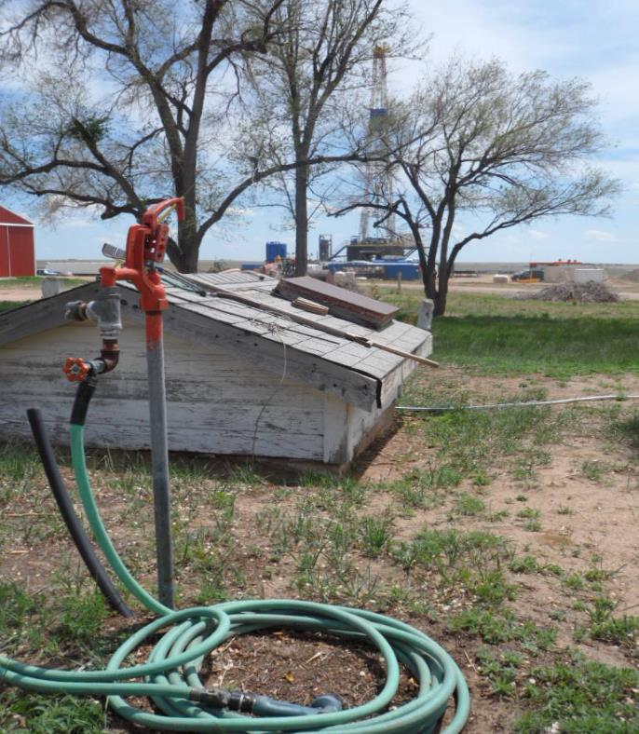
Typical Sample Location
Typical compliance costs:
Sampling: $2,500
Lab analysis: $500 - 600
Isotopic analysis, if needed: $300 - 400 more
Photo courtesy of
Ben Baugh
Olsson Associates
www.geotech.com

Slide 12
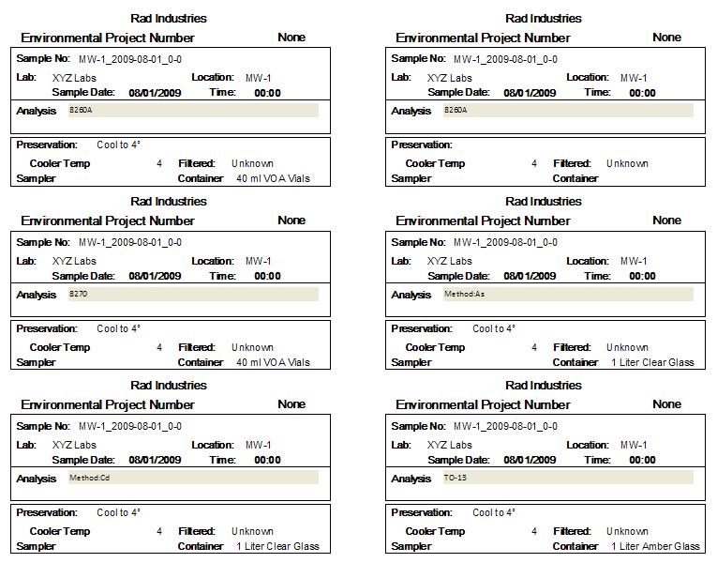
Container Labels
www.geotech.com

Slide 13
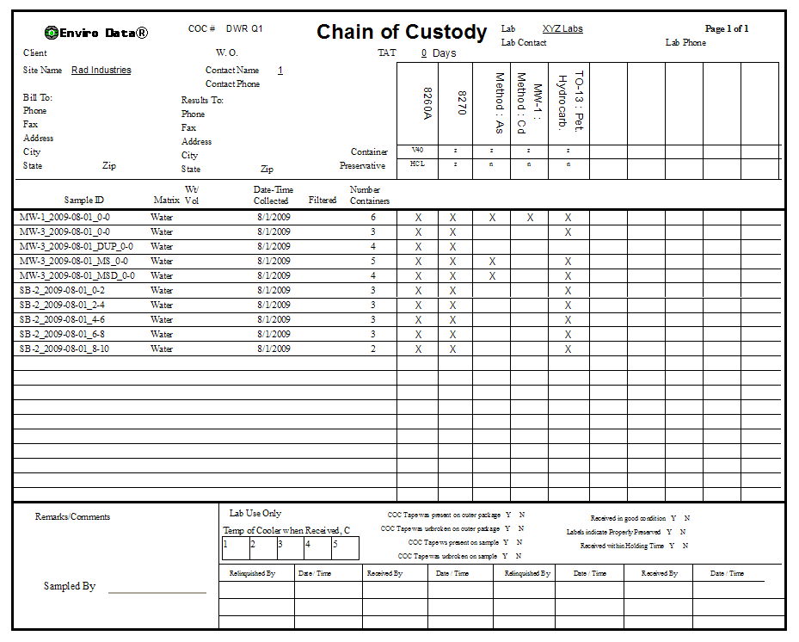
Planning the sample event
www.geotech.com

Slide 14
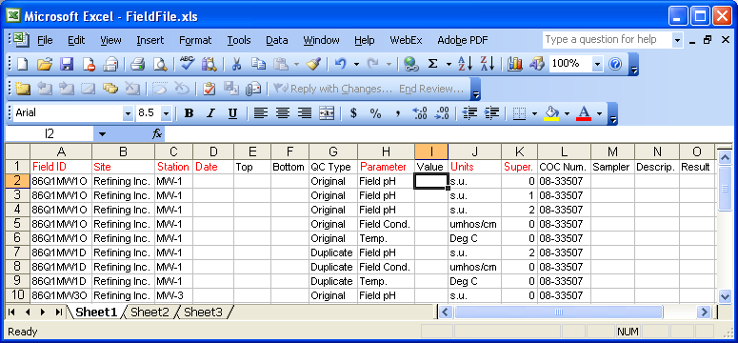
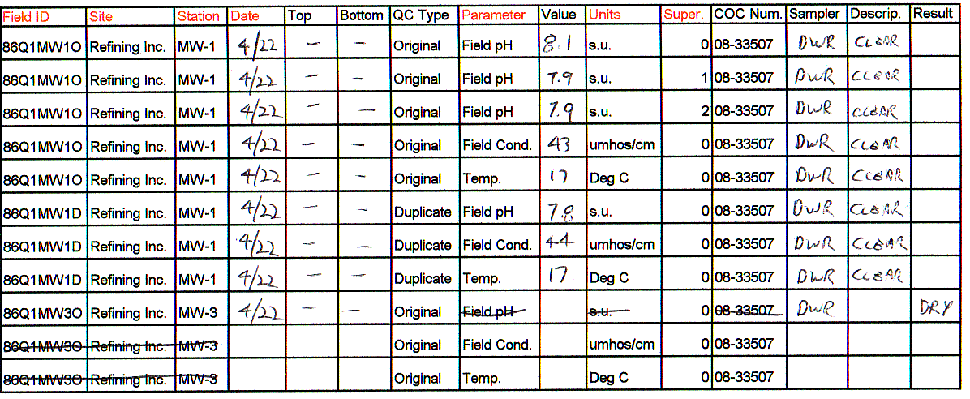
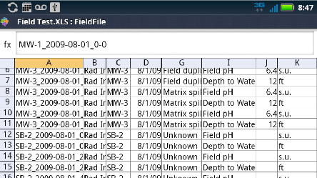
Gathering Field Data
www.geotech.com

Slide 15
Required Analyses
Required Analyses for Rules 318A and 609 pre-drilling samples
pH
Specific Conductance
Total Dissolved Solids*
Dissolved Gases (methane, ethane, propane)*
Total Alkalinity as CaCO3*
Bicarbonate Alkalinity as CaCO3*
Carbonate Alkalinity as CaCO3*
Major Anions (bromide*, chloride*, fluoride*, sulfate*, nitrate, nitrite as N, phosphorus)
Major Cations (calcium*, iron, magnesium*, manganese, potassium*, sodium*)
Other Elements (barium, boron, selenium, strontium)
Bacteria (iron related, sulfate reducing, slime, coliform)
Total Petroleum Hydrocarbons*
BTEX (benzene, toluene, ethylbenzene, xylenes)*
Field Observations (odor, water color, sediment, bubbles, effervescence)
Gas Composition (if methane exceeds 1mg/L)
Stable Isotopes of methane and water (if methane exceeds 1 mg/L)
Notes: 1. All of the above analyses must be performed on pre-drilling samples. Analyses marked with an asterisk (*) are also required for post-drilling samples. 2. If free gas or a dissolved methane concentration greater than 1.0 milligram per liter (mg/l) is detected in a water sample, gas compositional analysis and stable isotope analysis of the methane (carbon and hydrogen – 12C, 13C, 1H and 2H) must also be performed to determine gas type. 3. Field observations such as odor, water color, sediment, bubbles, and effervescence must also be documented.
www.geotech.com

Slide 16
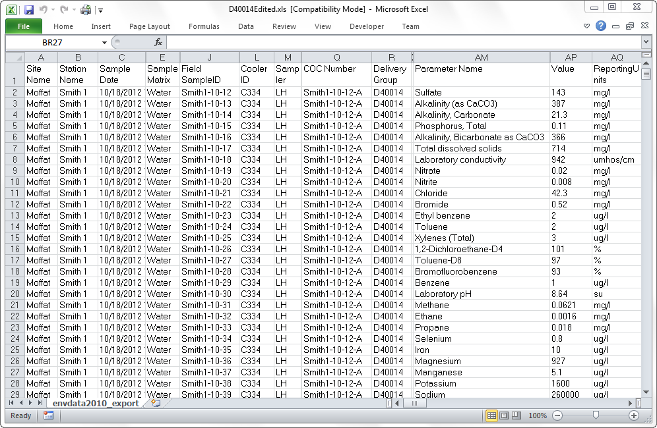
Example Laboratory Deliverable
www.geotech.com

Slide 17
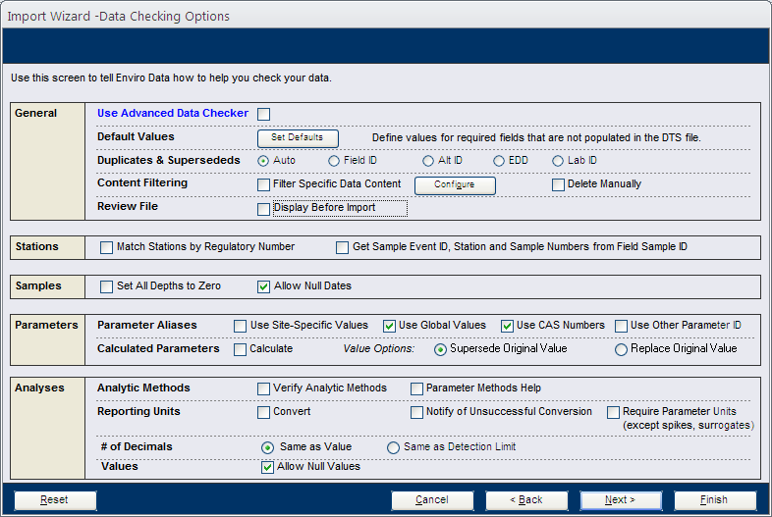
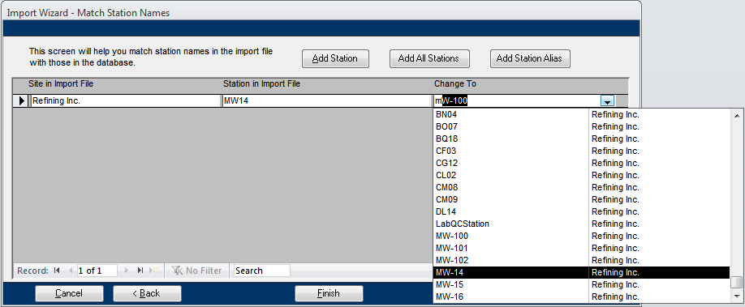
Importing Data
www.geotech.com

Slide 18
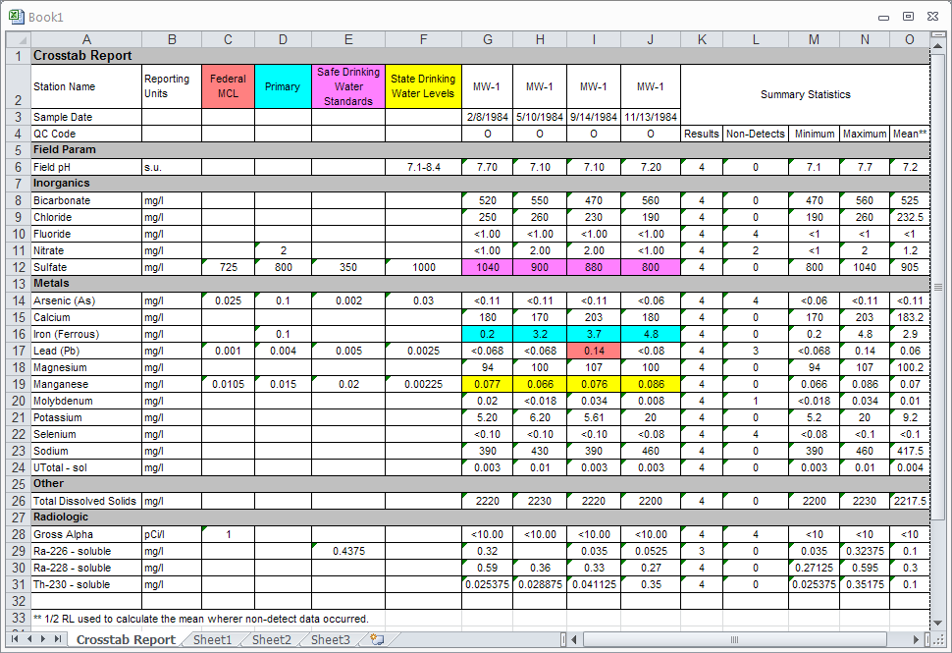
Excel Table for Review
www.geotech.com

Slide 19
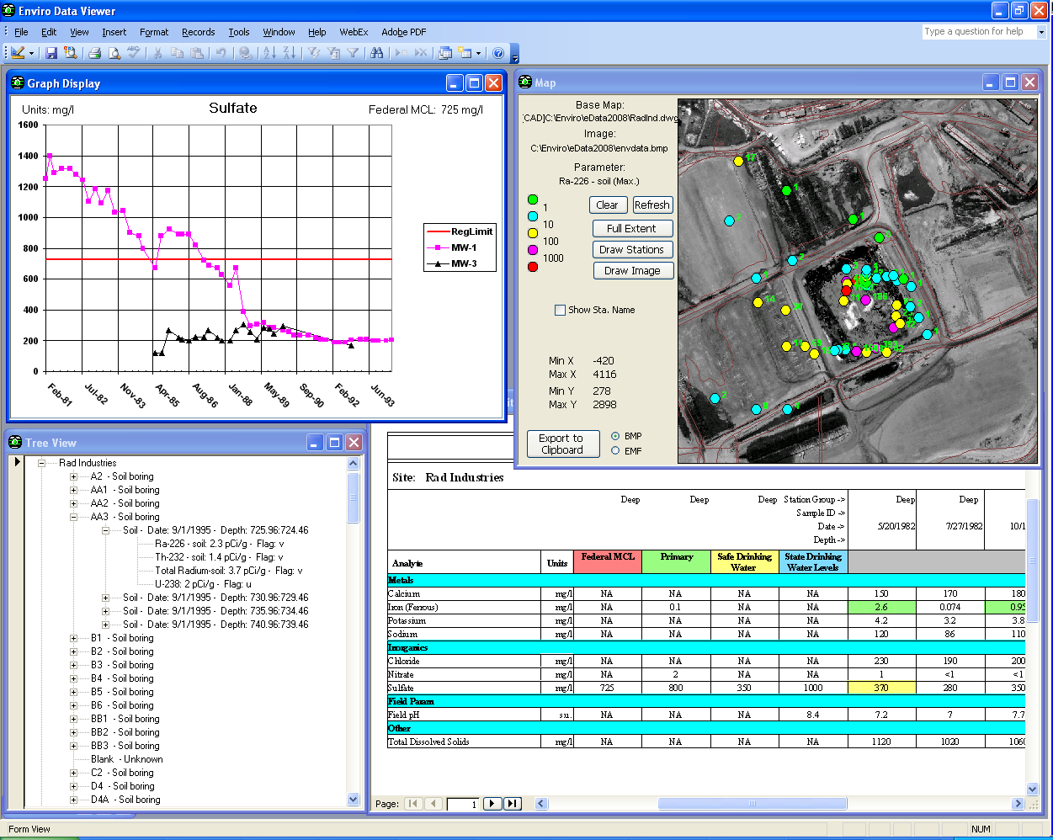
Introduction
www.geotech.com

Slide 20
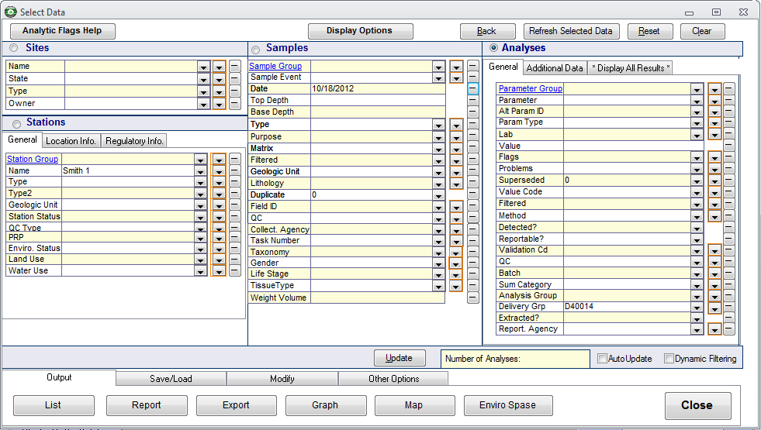
Selection and Output
www.geotech.com

Slide 21
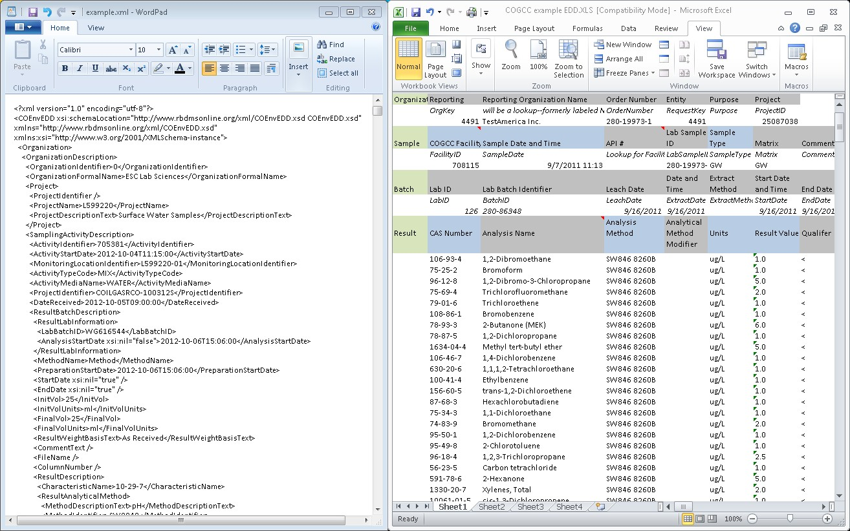
Exporting COGCC Format
Data files courtesy of Arthur Koepsell, COGCC
www.geotech.com

Slide 22
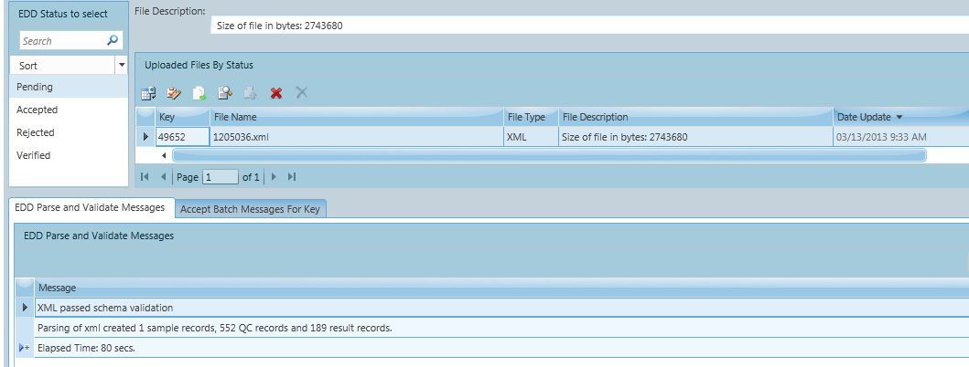
Uploading to COGCC
Upload data using COGCC website
Image courtesy of Arthur Koepsell, COGCC
www.geotech.com

Slide 23
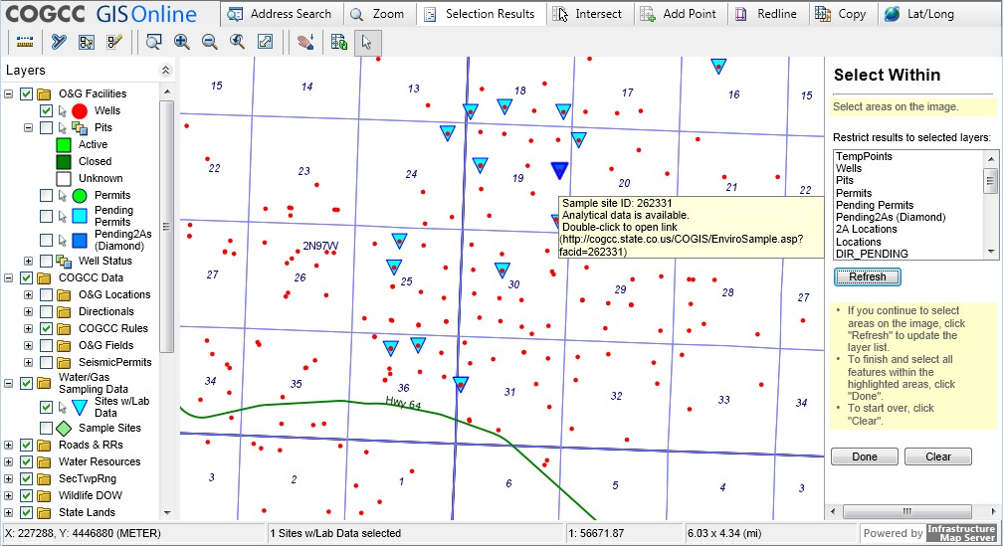
Map from COGCC website
www.geotech.com

Slide 24
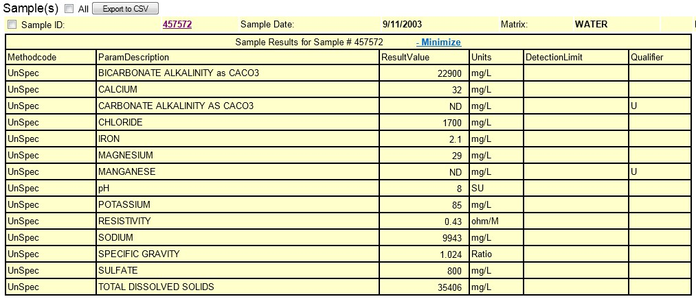
Data from COGCC website
www.geotech.com

Slide 25
Future Direction and Discussion
For COGCC, perhaps a way to download the Facility IDs and Sample IDs
More data retrieval options from website
Expansion to other states
Use by the public
Use in litigation
Other issues?
www.geotech.com

Slide 26
Data Management for the New and Expected Baseline Sampling Rules
www.geotech.com
Dr. David W. Rich
drdave@geotech.com
Denver, CO
May 6, 2014

